Slide 1
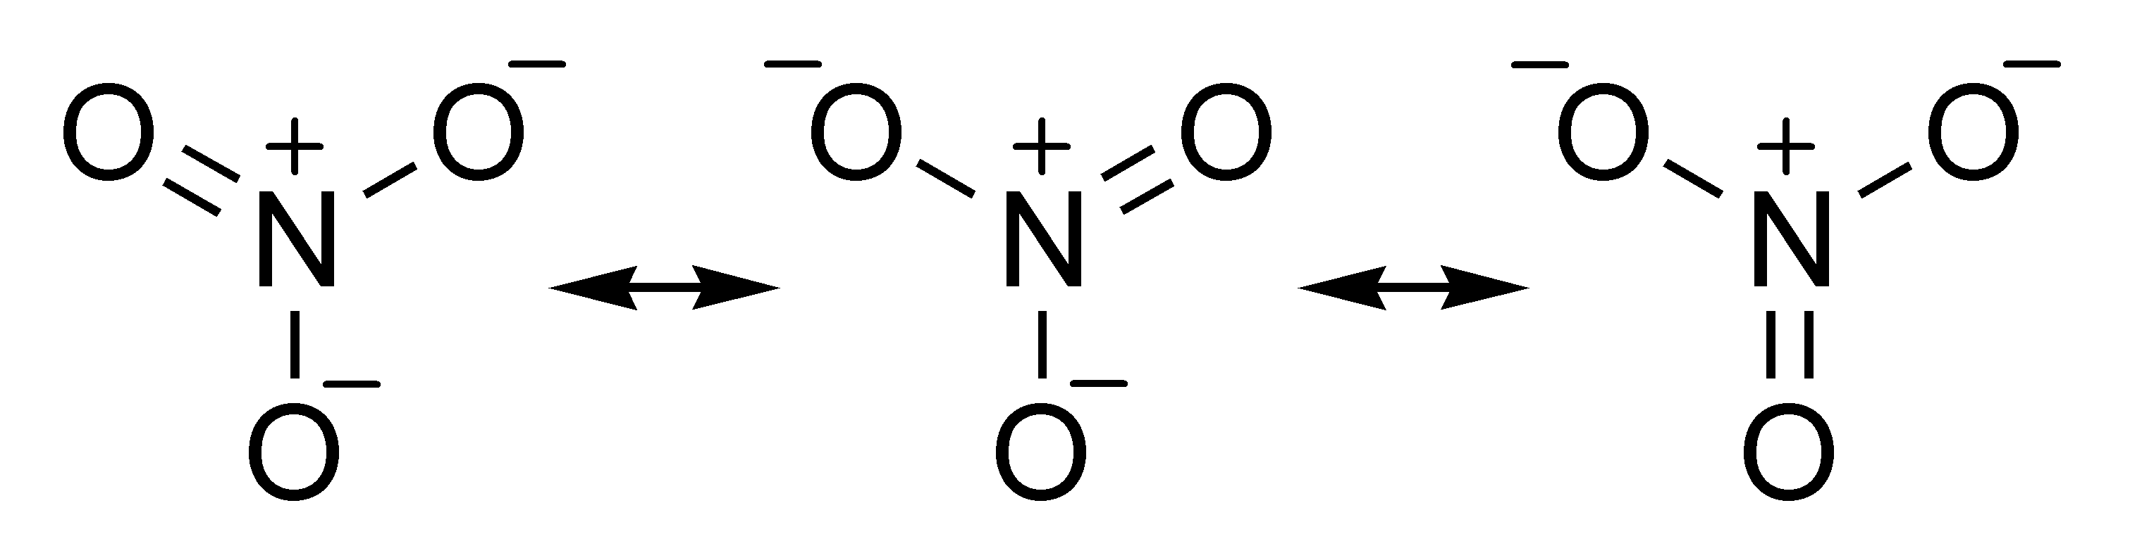

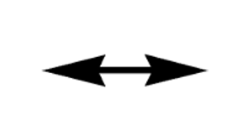
Practice … can you draw two other (equivalent) resonance forms?

Slide 2
Practice … can you draw two other (equivalent) resonance forms?

Slide 3
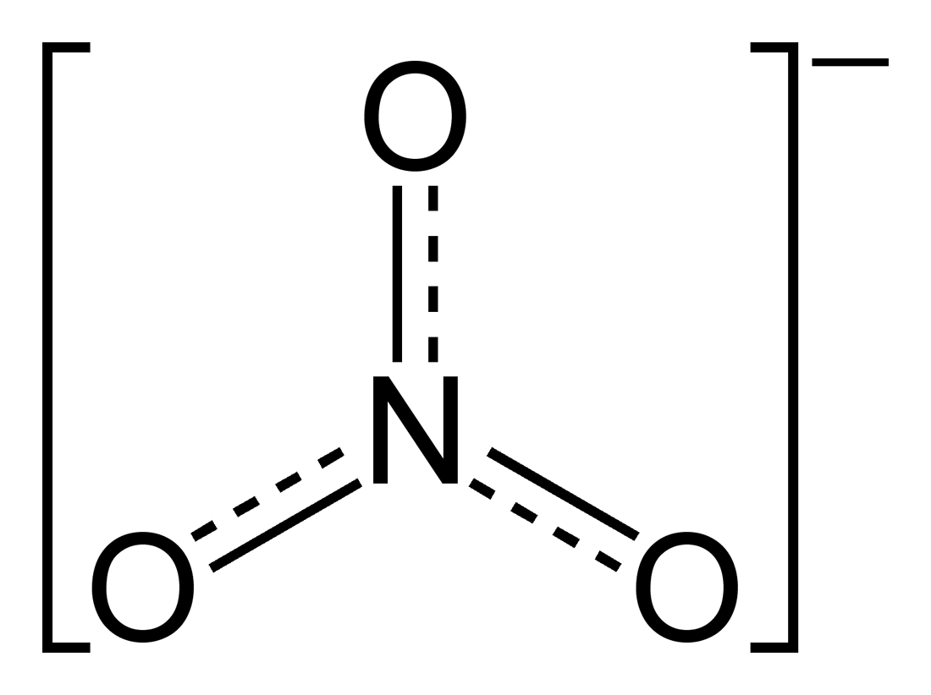
Practice … estimating resonance-averaged properties
33%
33%
33%
Combine all three
Bond orders

Slide 4
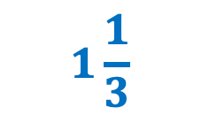
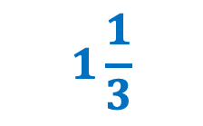

Practice … estimating resonance-averaged properties
33%
33%
33%
Combine all three
Bond orders
$$1\frac{1}{3}$$
$$1\frac{1}{3}$$
$$1\frac{1}{3}$$

Slide 5
Practice … estimating resonance-averaged properties
33%
33%
33%
Combine all three
Formal charges

Slide 6
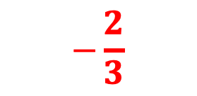
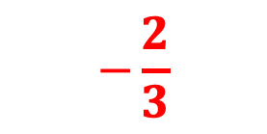

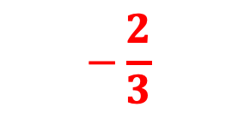
Practice … estimating resonance-averaged properties
33%
33%
33%
Combine all three
$$−\frac{2}{3}$$
Formal charges
$$+1$$
$$−\frac{2}{3}$$
$$−\frac{2}{3}$$

Slide 7
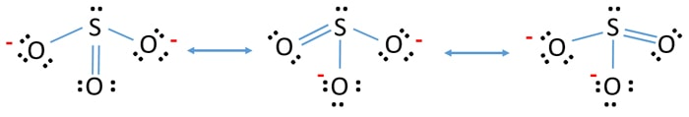
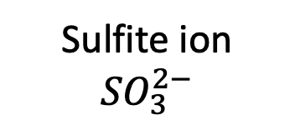
More practice …
Sulfite ion
$${SO}_{3}^{2−}$$
Resonance-averaged bond order = …
Resonance-averaged formal charge on oxygens = …

Slide 8
More practice …
Sulfite ion
$${SO}_{3}^{2−}$$
Resonance-averaged bond order = $1\frac{1}{3}$
Resonance-averaged formal charge on oxygens = …

Slide 9
More practice …
Sulfite ion
$${SO}_{3}^{2−}$$
Resonance-averaged bond order = $1\frac{1}{3}$
Resonance-averaged formal charge on oxygens = $−\frac{2}{3}$

Slide 10
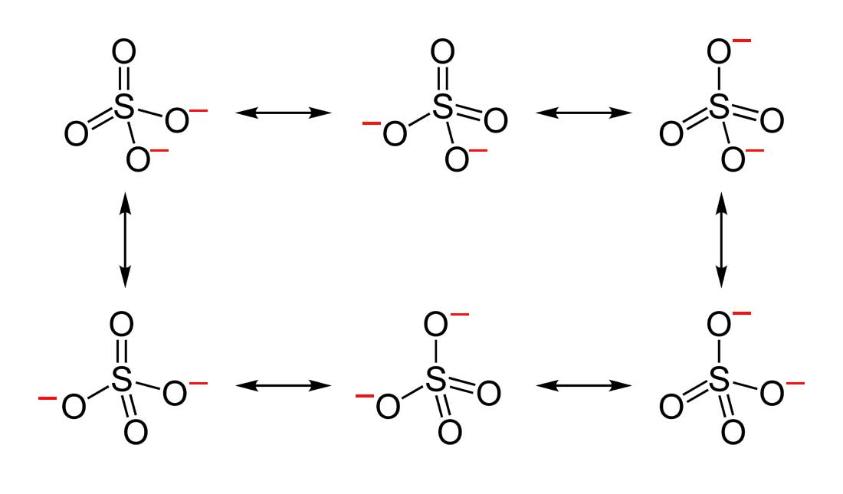
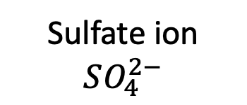
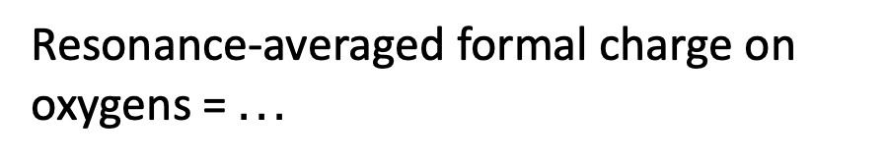

More practice …
Sulfate ion
$$SO_{4}^{2−}$$
Resonance-averaged bond order = $…$
Resonance-averaged formal charge on oxygens = $...$

Slide 11
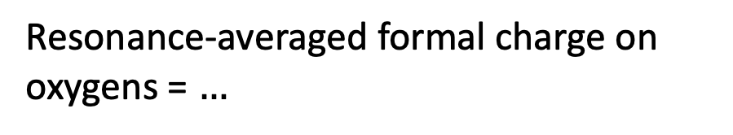
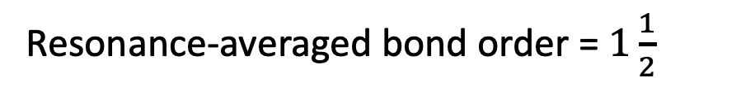
More practice …
Sulfate ion
$$SO_{4}^{2−}$$
Resonance-averaged bond order = $1\frac{1}{2}$
Resonance-averaged formal charge on oxygens = $…$

Slide 12
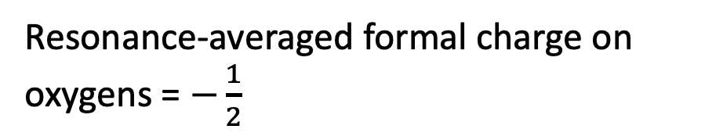
More practice …
Sulfate ion
$$SO_{4}^{2−}$$
Resonance-averaged bond order = $1\frac{1}{2}$
Resonance-averaged formal charge on oxygens = $−\frac{1}{2}$

Slide 13
Remaining tasks for today …
Review of the 8−12 𝜇𝑚 atmospheric window
Ozone as a greenhouse gas (in the stratosphere)
Photosynthesis

Slide 14
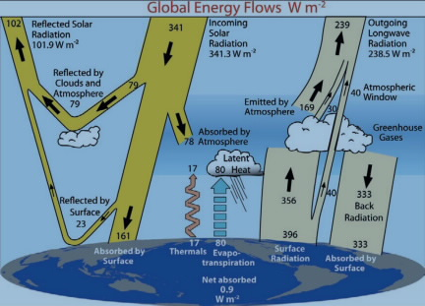
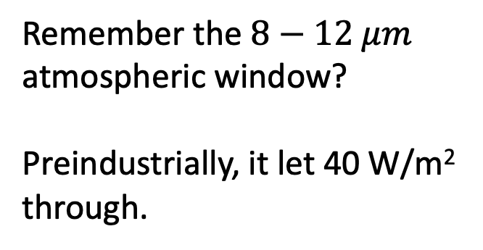
Focus on the 8−12 𝜇𝑚 atmospheric window
Remember the $8−12 μm$ atmospheric window?
Preindustrially, it let 40 W/m² through.

Slide 15
Focus on the 8−12 𝜇𝑚 atmospheric window
Remember the $8−12 μm$ atmospheric window?
Preindustrially, it let 40 W/m² through.

Slide 16
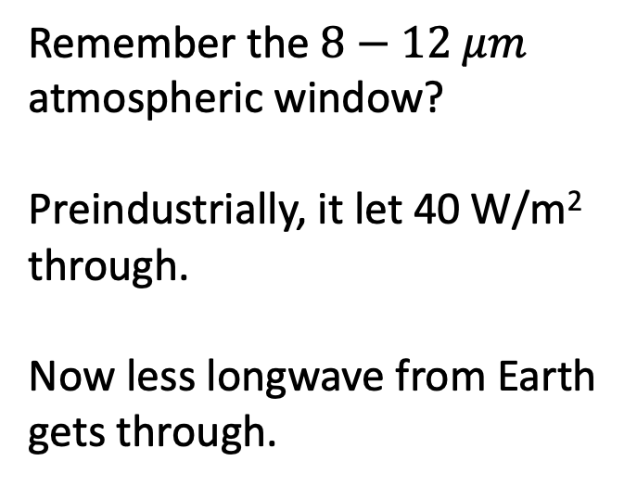
Focus on the 8−12 𝜇𝑚 atmospheric window
Remember the $8−12 μm$ atmospheric window?
Preindustrially, it let 40 W/m² through.
Now less longwave from Earth gets through.
36

Slide 17
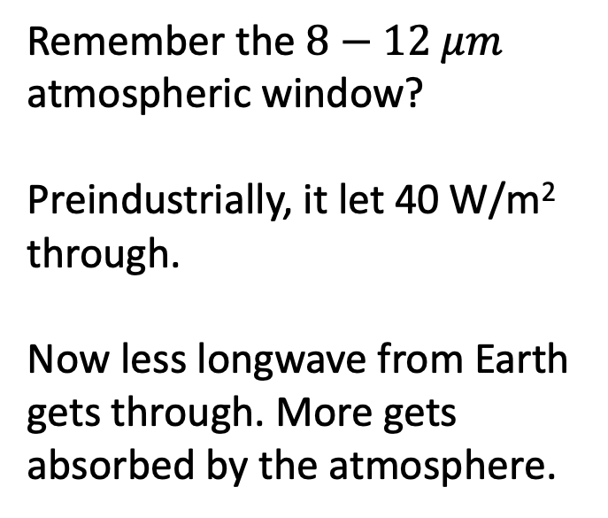
Focus on the 8−12 𝜇𝑚 atmospheric window
Remember the $8−12 μm$ atmospheric window?
Preindustrially, it let 40 W/m² through.
Now less longwave from Earth gets through. More gets absorbed by the atmosphere.
36

Slide 18
Focus on the 8−12 𝜇𝑚 atmospheric window
Remember the $8−12 μm$ atmospheric window?
Preindustrially, it let 40 W/m² through.
Now less longwave from Earth gets through. More gets absorbed by the atmosphere.
36
360

Slide 19
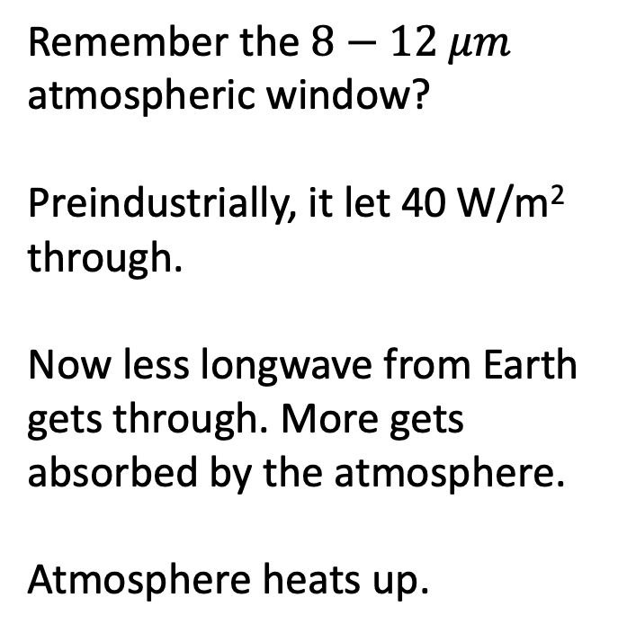
Focus on the 8−12 𝜇𝑚 atmospheric window
Remember the $8−12 μm$ atmospheric window?
Preindustrially, it let 40 W/m² through.
Now less longwave from Earth gets through. More gets absorbed by the atmosphere.
Atmosphere heats up.
36
360

Slide 20
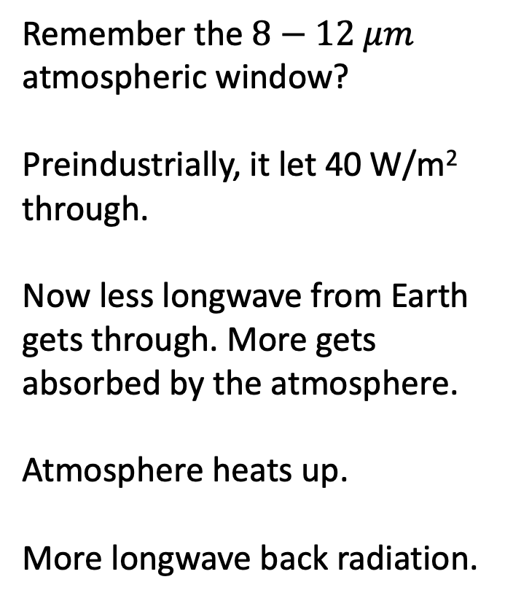
Focus on the 8−12 𝜇𝑚 atmospheric window
Remember the $8−12 μm$ atmospheric window?
Preindustrially, it let 40 W/m² through.
Now less longwave from Earth gets through. More gets absorbed by the atmosphere.
Atmosphere heats up.
More longwave back radiation.
36
360

Slide 21
Focus on the 8−12 𝜇𝑚 atmospheric window
Remember the $8−12 μm$ atmospheric window?
Preindustrially, it let 40 W/m² through.
Now less longwave from Earth gets through. More gets absorbed by the atmosphere.
Atmosphere heats up.
More longwave back radiation.
36
360
+2.6 W/m²

Slide 22
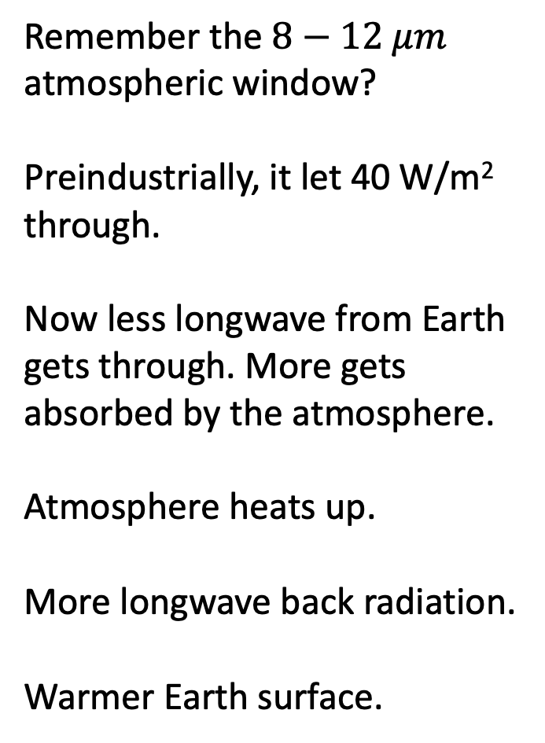
Focus on the 8−12 𝜇𝑚 atmospheric window
Remember the $8−12 μm$ atmospheric window?
Preindustrially, it let 40 W/m² through.
Now less longwave from Earth gets through. More gets absorbed by the atmosphere.
Atmosphere heats up.
More longwave back radiation.
Warmer Earth surface.
36
360
+2.6 W/m²
+1.2 ºC

Slide 23
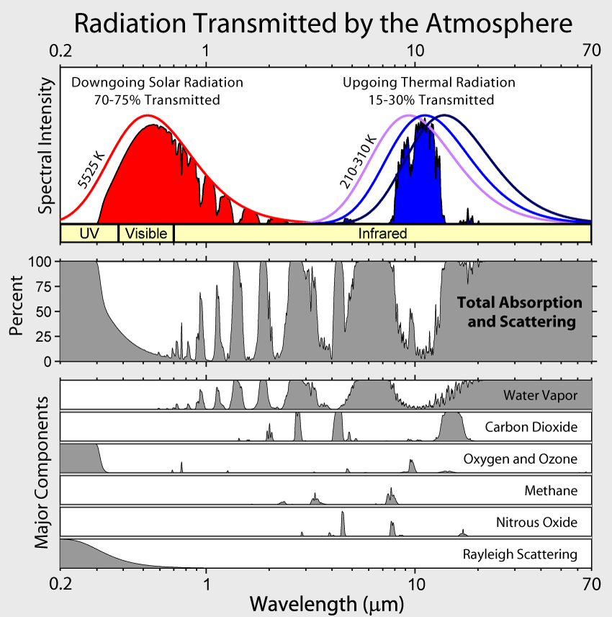
8−12 𝜇𝑚 atmospheric window is a spectral window
40 W/m²
What does that mean?

Slide 24
8−12 𝜇𝑚 atmospheric window is a spectral window
8
12
40 W/m²
What does that mean?
Longwave radiation emitted by Earth’s surface, in the range 8−12 𝜇𝑚, gets a free pass out to space. All the rest gets absorbed by the atmosphere.

Slide 25
8−12 𝜇𝑚 atmospheric window is getting narrower
8
12
40 W/m²
What does that mean?
Longwave radiation emitted by Earth’s surface, in the range 8−12 𝜇𝑚, gets a free pass out to space. All the rest gets absorbed by the atmosphere.

Slide 26
8−12 𝜇𝑚 atmospheric window is getting narrower
8
12
36 W/m²
What does that mean?
Longwave radiation emitted by Earth’s surface, in the range 8−12 𝜇𝑚, gets a free pass out to space. All the rest gets absorbed by the atmosphere.

Slide 27
Why is the 8−12 𝜇𝑚 atmospheric window getting more narrow?
8
12
36 W/m²
We’re already seen that the narrowing on the 12 𝜇𝑚 side is due to more CO₂.

Slide 28
Why is the 8−12 𝜇𝑚 atmospheric window getting more narrow?
8
12
36 W/m²
We’re already seen that the narrowing on the 12 𝜇𝑚 side is due to more CO₂.

Slide 29
Why is the 8−12 𝜇𝑚 atmospheric window getting more narrow?
8
12
36 W/m²
We’re already seen that the narrowing on the 12 𝜇𝑚 side is due to more CO₂.
As the atmosphere warms, it gets more humid, so there’s also narrowing on the 8 𝜇𝑚 side due to more H₂O.

Slide 30
Why is the 8−12 𝜇𝑚 atmospheric window getting more narrow?
8
12
36 W/m²
We’re already seen that the narrowing on the 12 𝜇𝑚 side is due to more CO₂.
As the atmosphere warms, it gets more humid, so there’s also narrowing on the 8 𝜇𝑚 side due to more H₂O.

Slide 31
Remaining tasks for today …
Review of the 8−12 𝜇𝑚 atmospheric window
Ozone as a greenhouse gas (in the stratosphere)
Photosynthesis

Slide 32
There’s also that absorption in the middle of the 8−12 𝜇𝑚 atmospheric window
8
12

Slide 33
There’s also that absorption in the middle of the 8−12 𝜇𝑚 atmospheric window
8
12
It’s due to ozone (O₃) in the stratosphere.

Slide 34
There’s also that absorption in the middle of the 8−12 𝜇𝑚 atmospheric window
8
12
It’s due to ozone (O₃) in the stratosphere.
What kind of vibrations makes ozone IR-active?

Slide 35
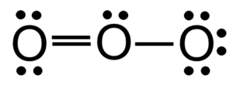
Your task for lab … Draw the two most important resonance forms for ozone

Slide 36
Your task for lab … Assign formal charges
…
+1
…

Slide 37
Your task for lab … Find resonance-averaged formal charges
+…
-…
-…

Slide 38
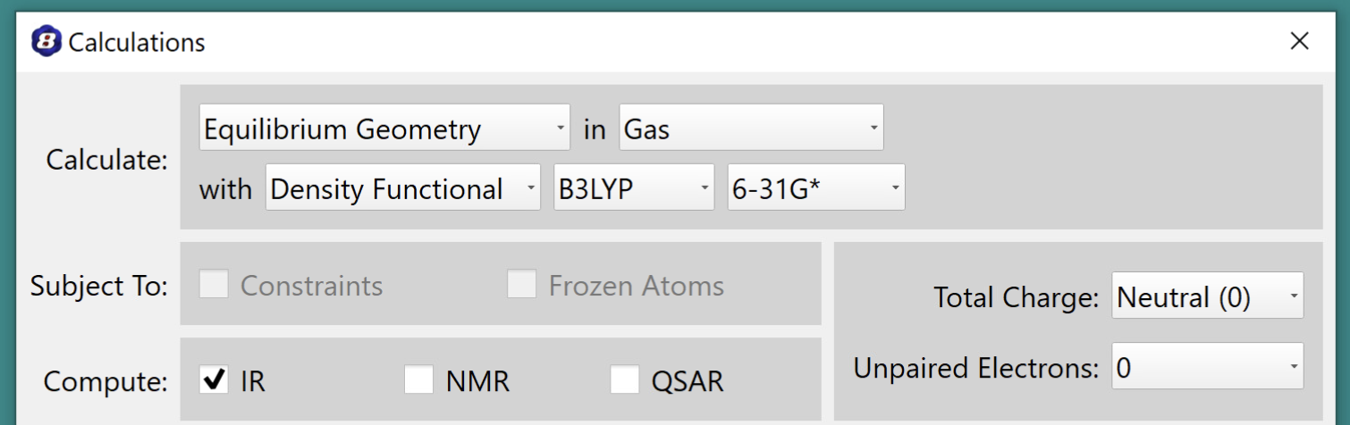
Your task for lab … Solve the electronic structure
You’ll need B3LYP for this

Slide 39
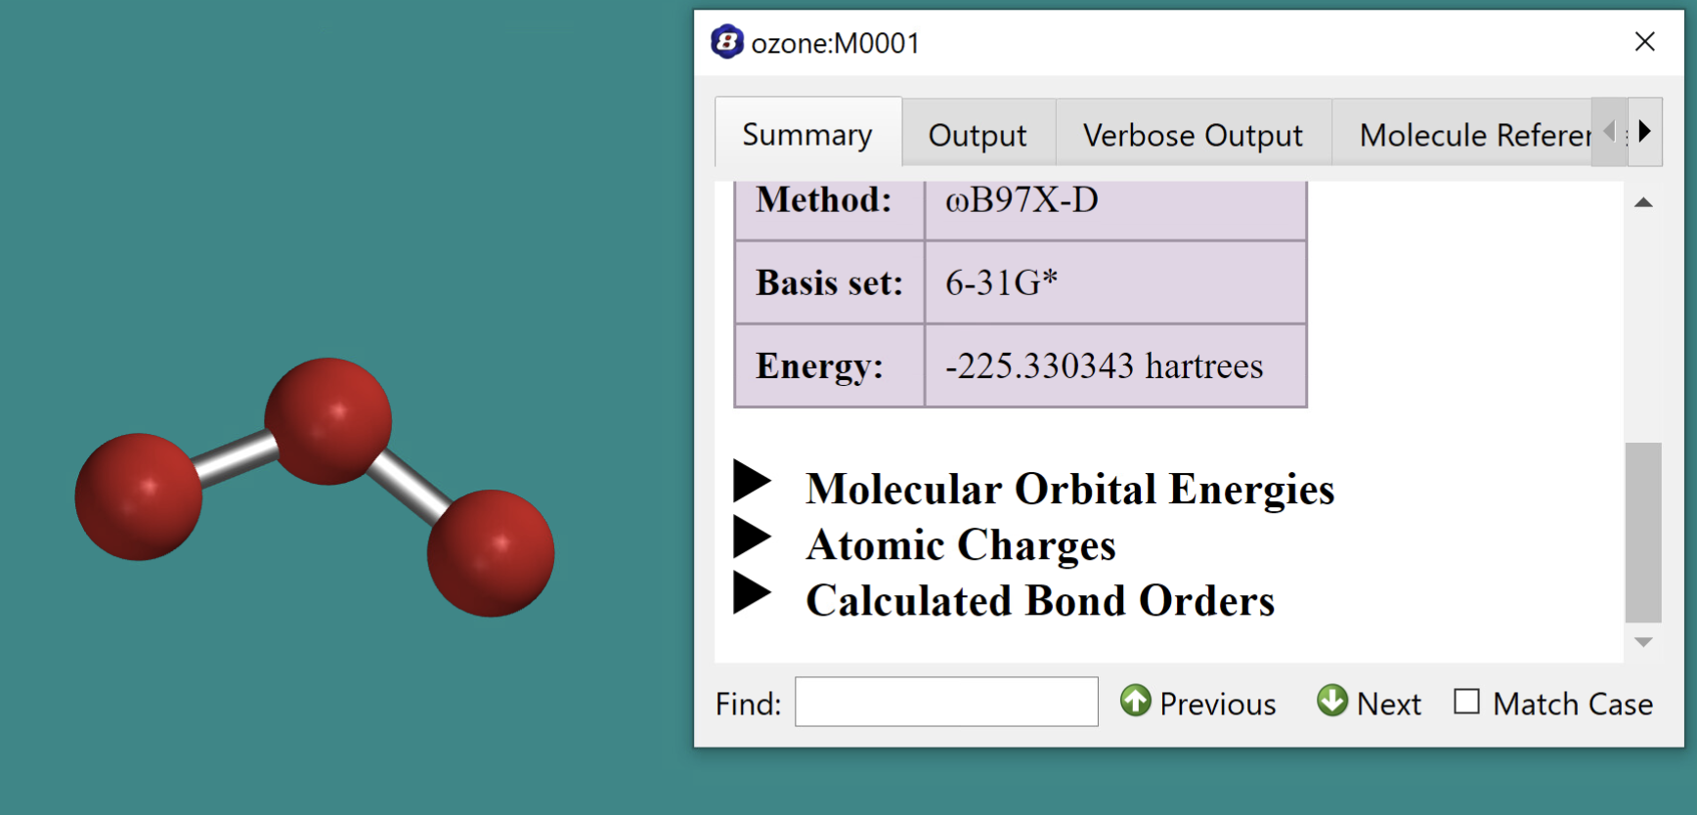
Your task for lab … See if Mullikin charges consistent with formal charges
Mullikin charge?
Mullikin charge?
Mullikin charge?

Slide 40
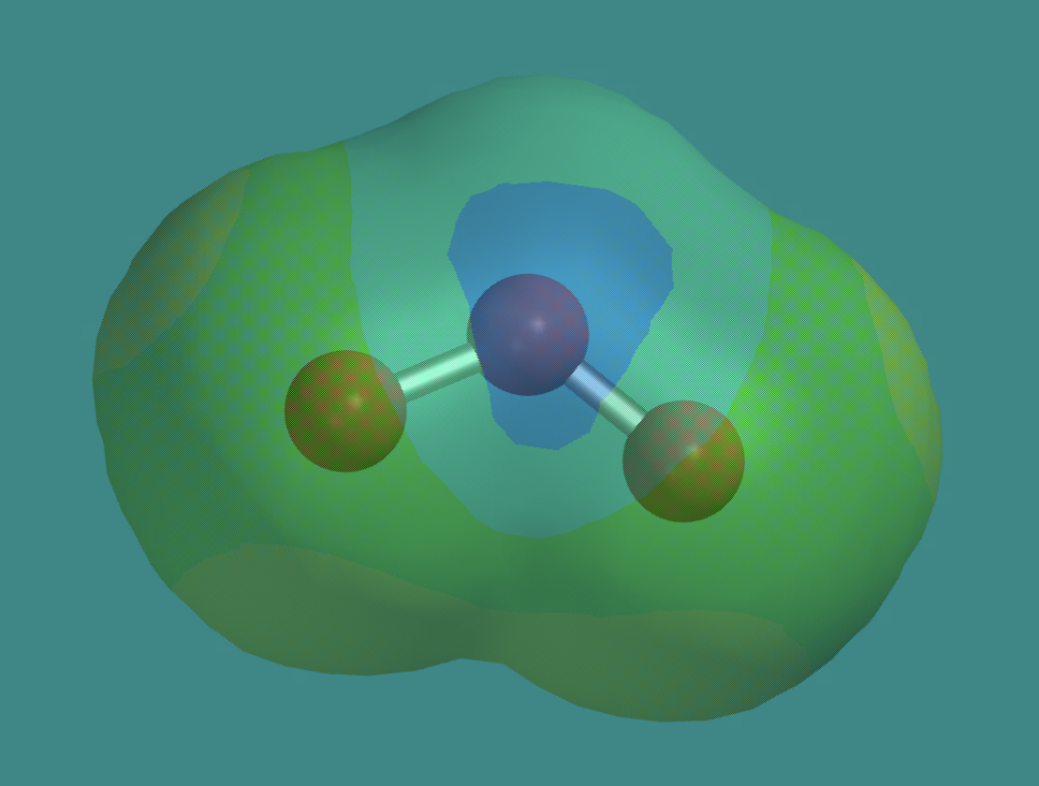
Your task for lab … See if the EPM is consistent with these charges
+
-
-
Electrostatic potential map
But you’ll have to remember the color coding.

Slide 41
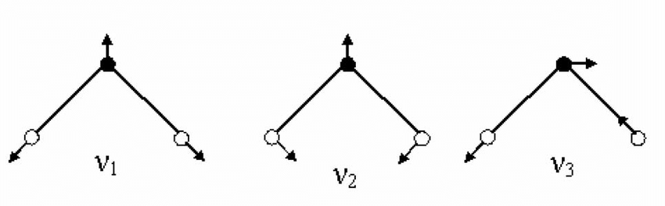
Your task for lab … Predict which vibrational motions might be IR-active
+
+
-
-
-
-
Symmetric stretch
Asymmetric stretch
Bend

Slide 42
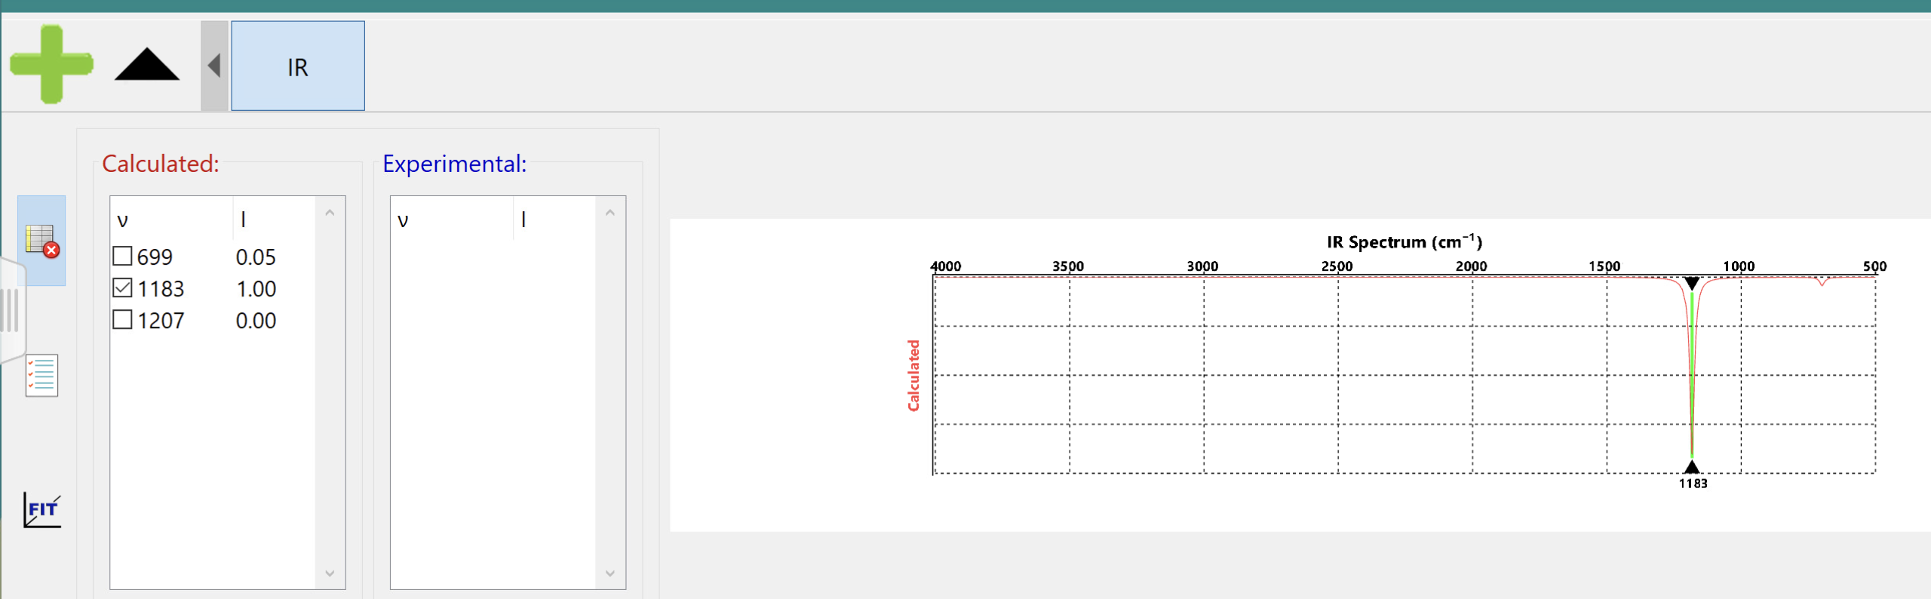
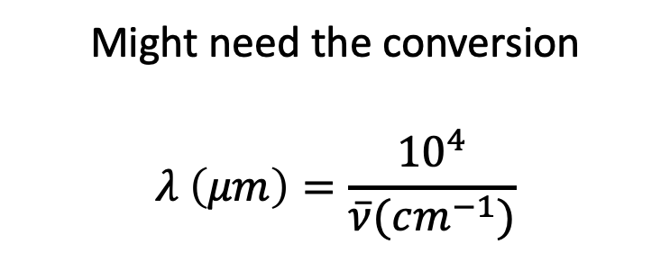
Your task for lab … Use Spartan to ID the peak in the 8−12 𝜇𝑚 window
Might need the conversion
$$λ \left(μm\right)=\frac{{10}^{4}}{\overline{ν}(cm^{−1})}$$

Slide 43
Remaining tasks for today …
Review of the 8−12 𝜇𝑚 atmospheric window
Ozone as a greenhouse gas (in the stratosphere)
Photosynthesis

Slide 44
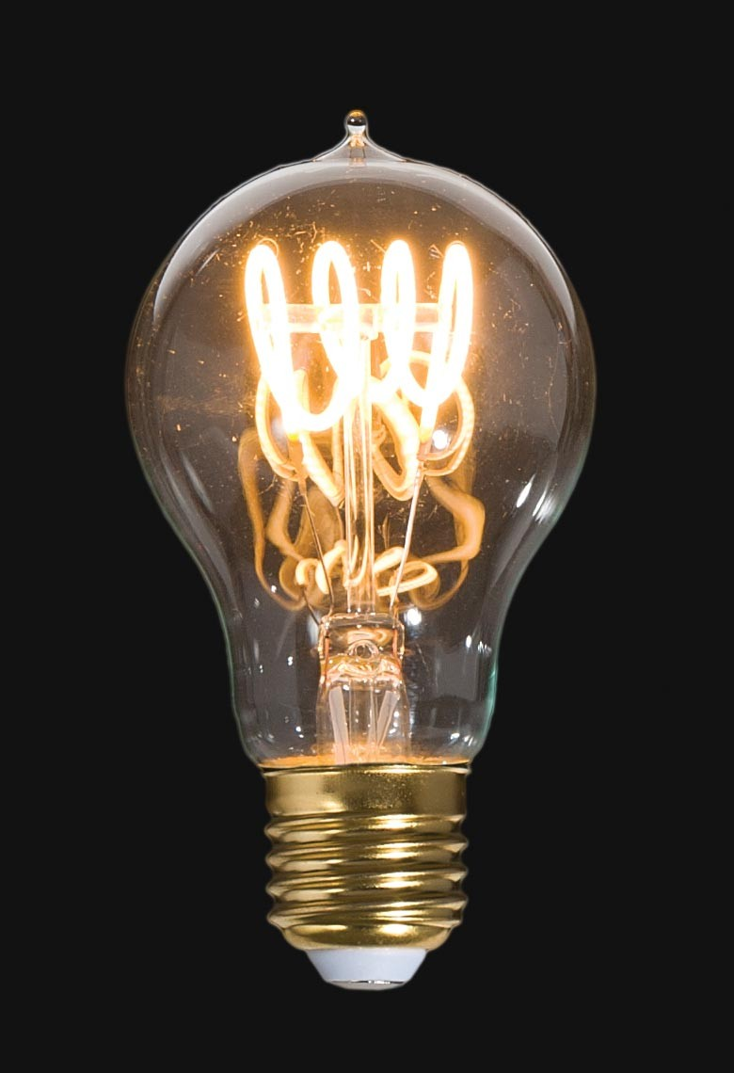

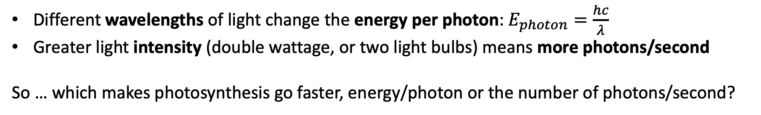
Einstein’s big idea (well, one of them)
A 100-Watt light bulb
Two 100-Watt light bulbs
→ Twice as many photons/second
One 200-Watt light bulb → Twice as many photons/second
Different wavelengths of light change the energy per photon: $E_{photon}=\frac{hc}{λ}$
Greater light intensity (double wattage, or two light bulbs) means more photons/second
So … which makes photosynthesis go faster, energy/photon or the number of photons/second?

Slide 45
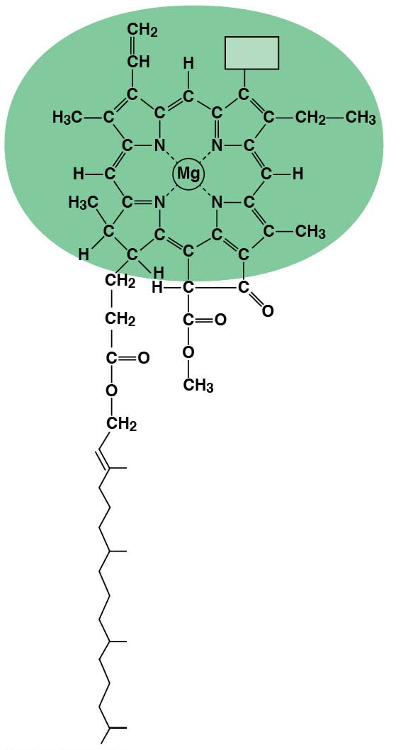
Your other task for lab: How does light intensity affect photosynthesis?
CH₃
The molecule Chlorophyll interacts with sunlight. The energy breaks the bonds in water molecules. Oxygen is “breathed out” by plants as waste and the other products are used to help plants make ATP (for energy) and glucose (a type of sugar).
Notes:
This is the simple cartoon I use to introduce photosynthesis to students.

Slide 46
Your other task for lab: How does light intensity affect photosynthesis?
CH₃
The molecule Chlorophyll interacts with sunlight. The energy breaks the bonds in water molecules. Oxygen is “breathed out” by plants as waste and the other products are used to help plants make ATP (for energy) and glucose (a type of sugar).
What’s the effect of light intensity?
What’s the effect of light wavelength?
2 H₂O → O₂ + 4 H⁺ + 4e⁻
-> ATP and glucose
Notes:
This is the simple cartoon I use to introduce photosynthesis to students.

Slide 47
Your other task for lab: How does light intensity affect photosynthesis?
CH₃
The molecule Chlorophyll interacts with sunlight. The energy breaks the bonds in water molecules. Oxygen is “breathed out” by plants as waste and the other products are used to help plants make ATP (for energy) and glucose (a type of sugar).
What’s the effect of light intensity?
-> According to Einstein, more photons/second)
What’s the effect of light wavelength?
2 H₂O → O₂ + 4 H⁺ + 4e⁻
-> ATP and glucose
Notes:
This is the simple cartoon I use to introduce photosynthesis to students.

Slide 48
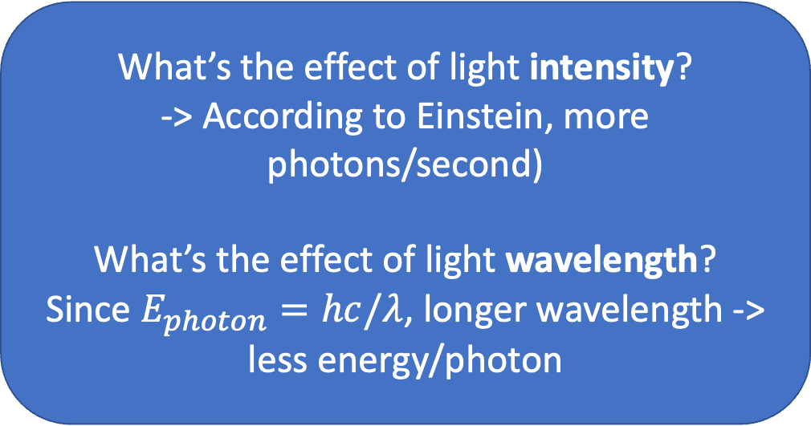
Your other task for lab: How does light intensity affect photosynthesis?
CH₃
The molecule Chlorophyll interacts with sunlight. The energy breaks the bonds in water molecules. Oxygen is “breathed out” by plants as waste and the other products are used to help plants make ATP (for energy) and glucose (a type of sugar).
What’s the effect of light intensity?
-> According to Einstein, more photons/second)
What’s the effect of light wavelength?
Since $E_{photon}=hc/λ$, longer wavelength -> less energy/photon
2 H₂O → O₂ + 4 H⁺ + 4e⁻
-> ATP and glucose
Notes:
This is the simple cartoon I use to introduce photosynthesis to students.

Slide 49
